Slide 1

ENVIRONMENTAL SCIENCE AND TECHNOLOGY
TEAM 1
IIIT H
Crop Diversity and Drought Resilience
We tested whether countries that grow a wider mix of crops lose less agricultural production in droughts, using 31 years of data for 107 countries.
Pranav Swarup Kumar · Prathmesh Sharma · Pragya Mishra · Gursahib Singh · Arushi Tandon

Slide 2



PROBLEM STATEMENT
02 / 26
The question and what we add
Does growing a wider mix of crops make a country’s agricultural production more resilient to drought?
Four faces of resilience
Response diversity
Cropland-weighted drought
Stability, resistance, recovery and vulnerability, each measured separately.
How differently a country’s crops react to drought, not only how many it grows.
Drought averaged over where crops grow, not over whole countries.
107
157
1993–2023
232
countries
crops
31 years
drought events analysed

Slide 3
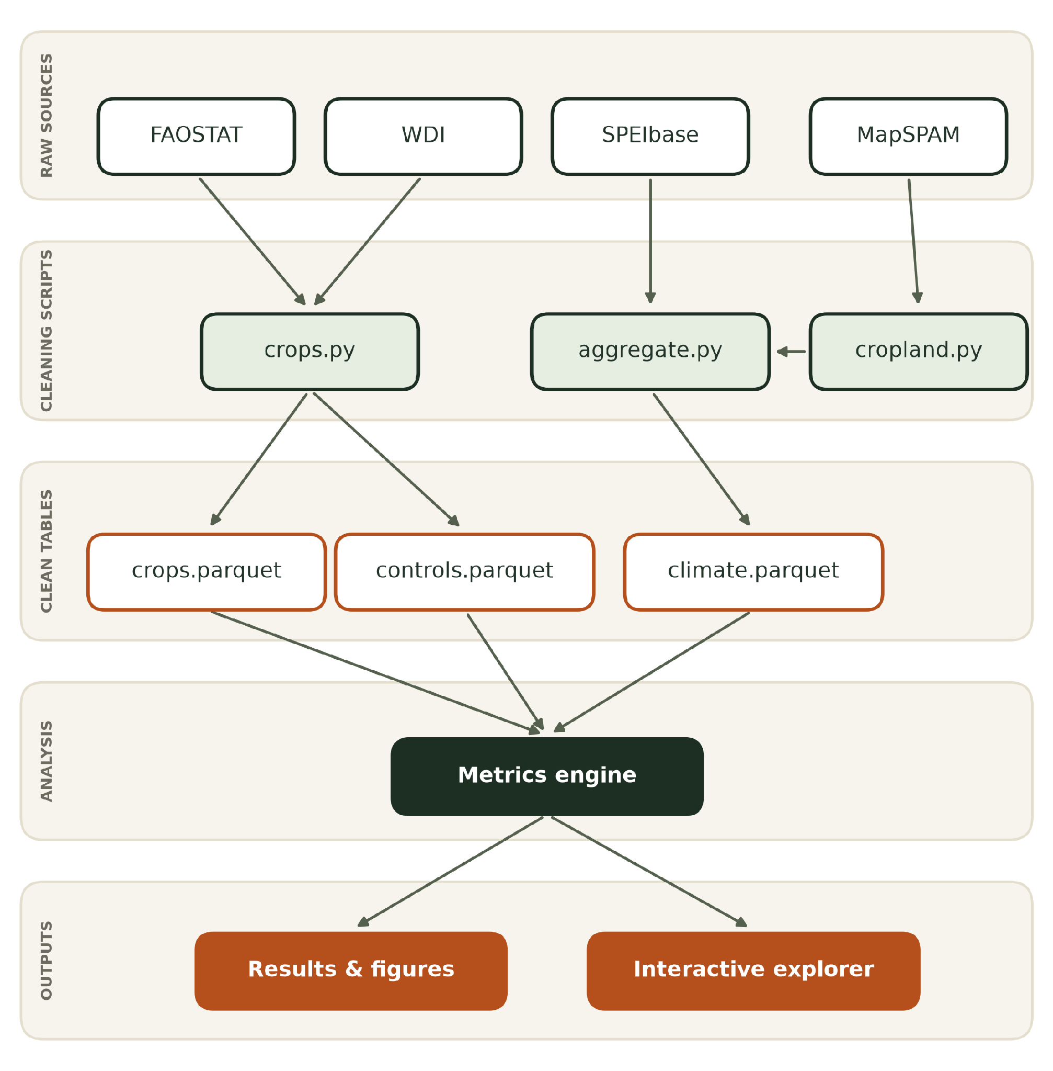
DATA USED
03 / 26
From four public datasets to country results
Source | Used for
FAOSTAT | Crop area, production and value
SPEIbase v2.10 | Drought index on a 0.5° grid
MapSPAM 2020 | Where each of 46 crops grows
World Bank WDI | Income and fertiliser use
Every step is a script that checks its own output. The results feed the figures in this deck and an interactive country explorer.
Also used: Natural Earth admin-0 boundaries for country shapes. FAOSTAT supplies QCL (production), QV (value of production) and RL (land use).

Slide 4


DATA USED
04 / 26
What each dataset contributes
FAOSTAT
SPEIbase v2.10
Crop production and value, 1993–2023
Drought index, monthly on a 0.5° grid to December 2023
QCL gives area harvested and production, QV the gross production value in constant 2014–16 international dollars, RL land use. After removing 11 aggregate items: 267,838 country-crop-years, 195 countries, 157 crops. 41% of rows carry an estimated or imputed flag. Where no value is published (3.8% of rows, 1.9% of value), we use production × the item’s price.
SPEI is precipitation minus potential evapotranspiration, standardised, so 0 is normal and −1 or below is drought. We use the 12-month index at December and the 6-month index, averaged per country and year: 7,130 country-years for 230 countries.
MapSPAM 2020 v2
World Bank WDI + FAOSTAT RL
Where 46 crops grow, 5 arc-minute grid
Control variables for the regressions
Physical harvested area, all technologies, summed to 1,274 million ha on the 0.5° grid (38,162 cells with cropland). It is one snapshot, used as the weight for the whole window, so we assume cropland does not move much between 1993 and 2023.
GDP per capita and fertiliser use (kg/ha) from WDI; irrigation share is irrigated land divided by cropland from FAOSTAT. Coverage is 95%, 91% and 90% of country-years. Merged entities (BLX, SCG, SDX) and Taiwan have no WDI series.
Country shapes and merged entities. Natural Earth 1:10m boundaries are dissolved to our codes. Belgium–Luxembourg (BLX), Serbia–Montenegro (SCG) and Sudan (SDX) are merged to keep series continuous across 1993–2023.

Slide 5
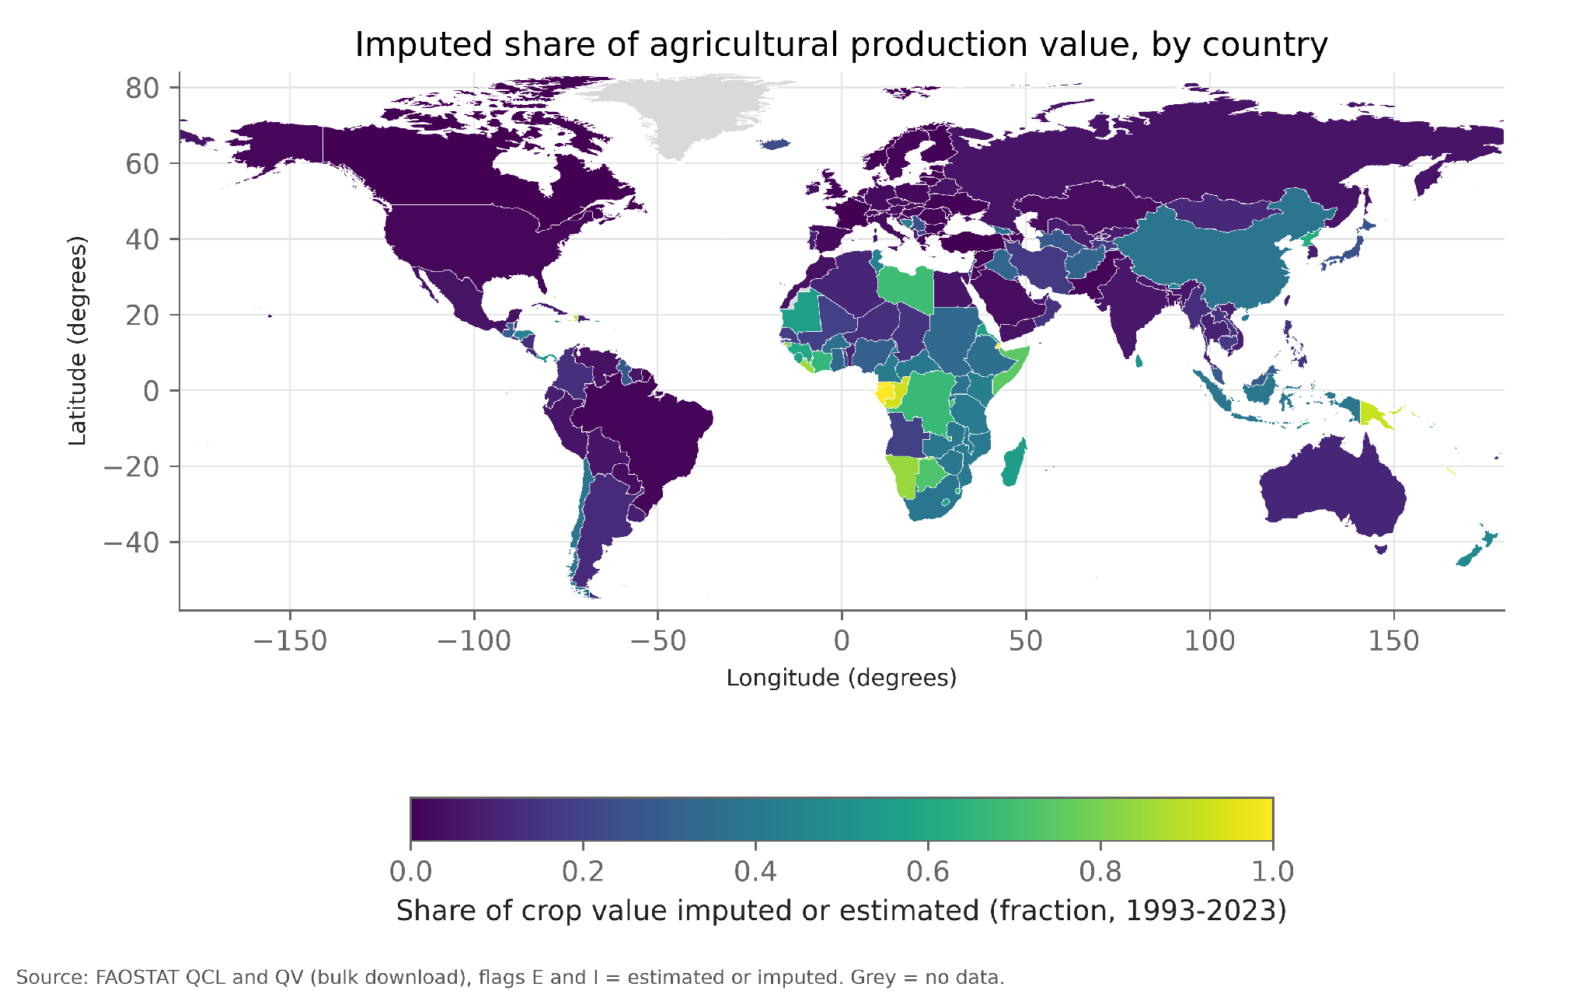
DATA USED
05 / 26
Which countries have data we can trust
107
of 195 countries included
A country needs 100,000 ha harvested, 5 crops and 25 years of mostly reported data. The map shades each country by the share of its crop value that FAOSTAT marks as estimated or imputed (dark = mostly reported); grey countries failed the rules. The 107 included countries hold 91% of global crop value.

Slide 6
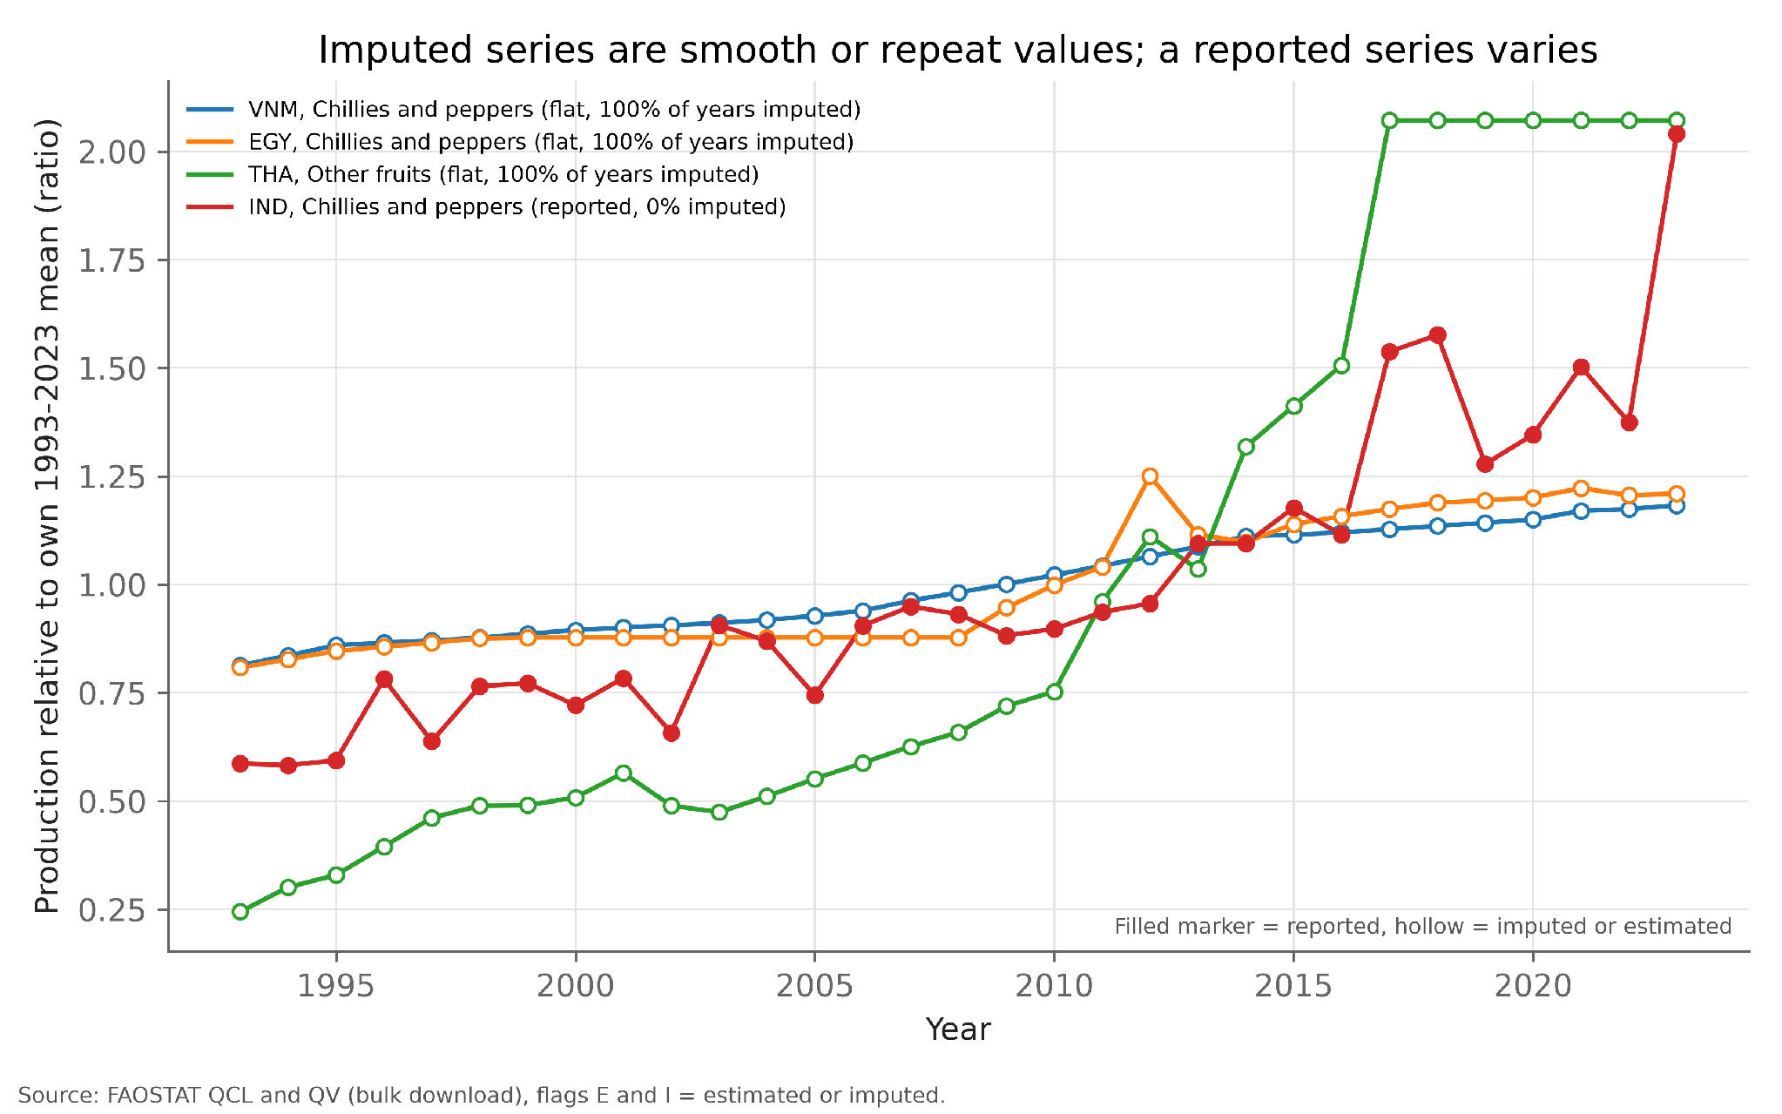
DATA USED
06 / 26
Why imputed data had to be screened
719
crop series flagged as flat
Each line is one crop’s production relative to its own mean; hollow markers are imputed years. The imputed series run smooth or repeat one value, which would look like stability when nothing was measured. We keep them in national totals but fit crop drought responses on reported years only.

Slide 7
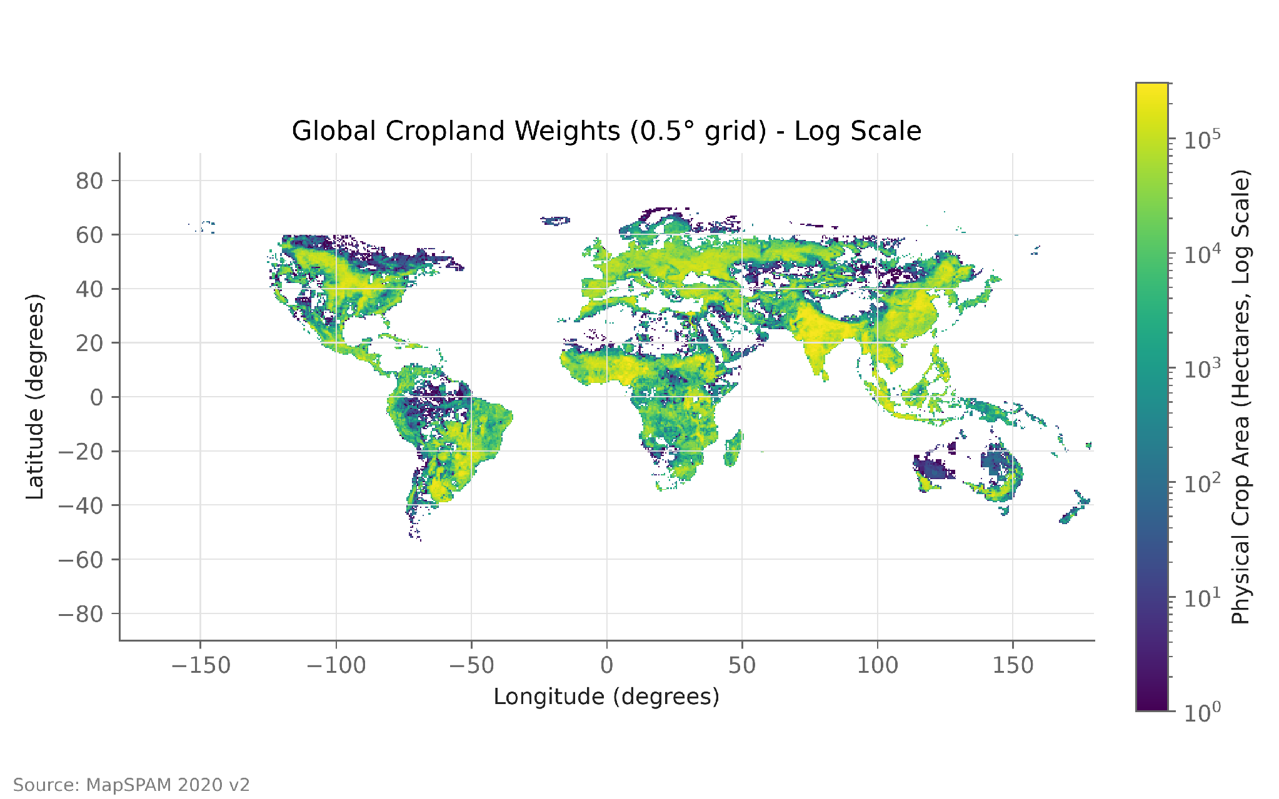
DATA USED
07 / 26
Where the world’s crops grow
1,274
million hectares of cropland
Each 0.5° grid cell is coloured by the physical area of 46 MapSPAM crops (log scale); 38,162 of 259,200 cells hold cropland. This area is the weight in every drought average, so deserts and ice count for nothing.

Slide 8
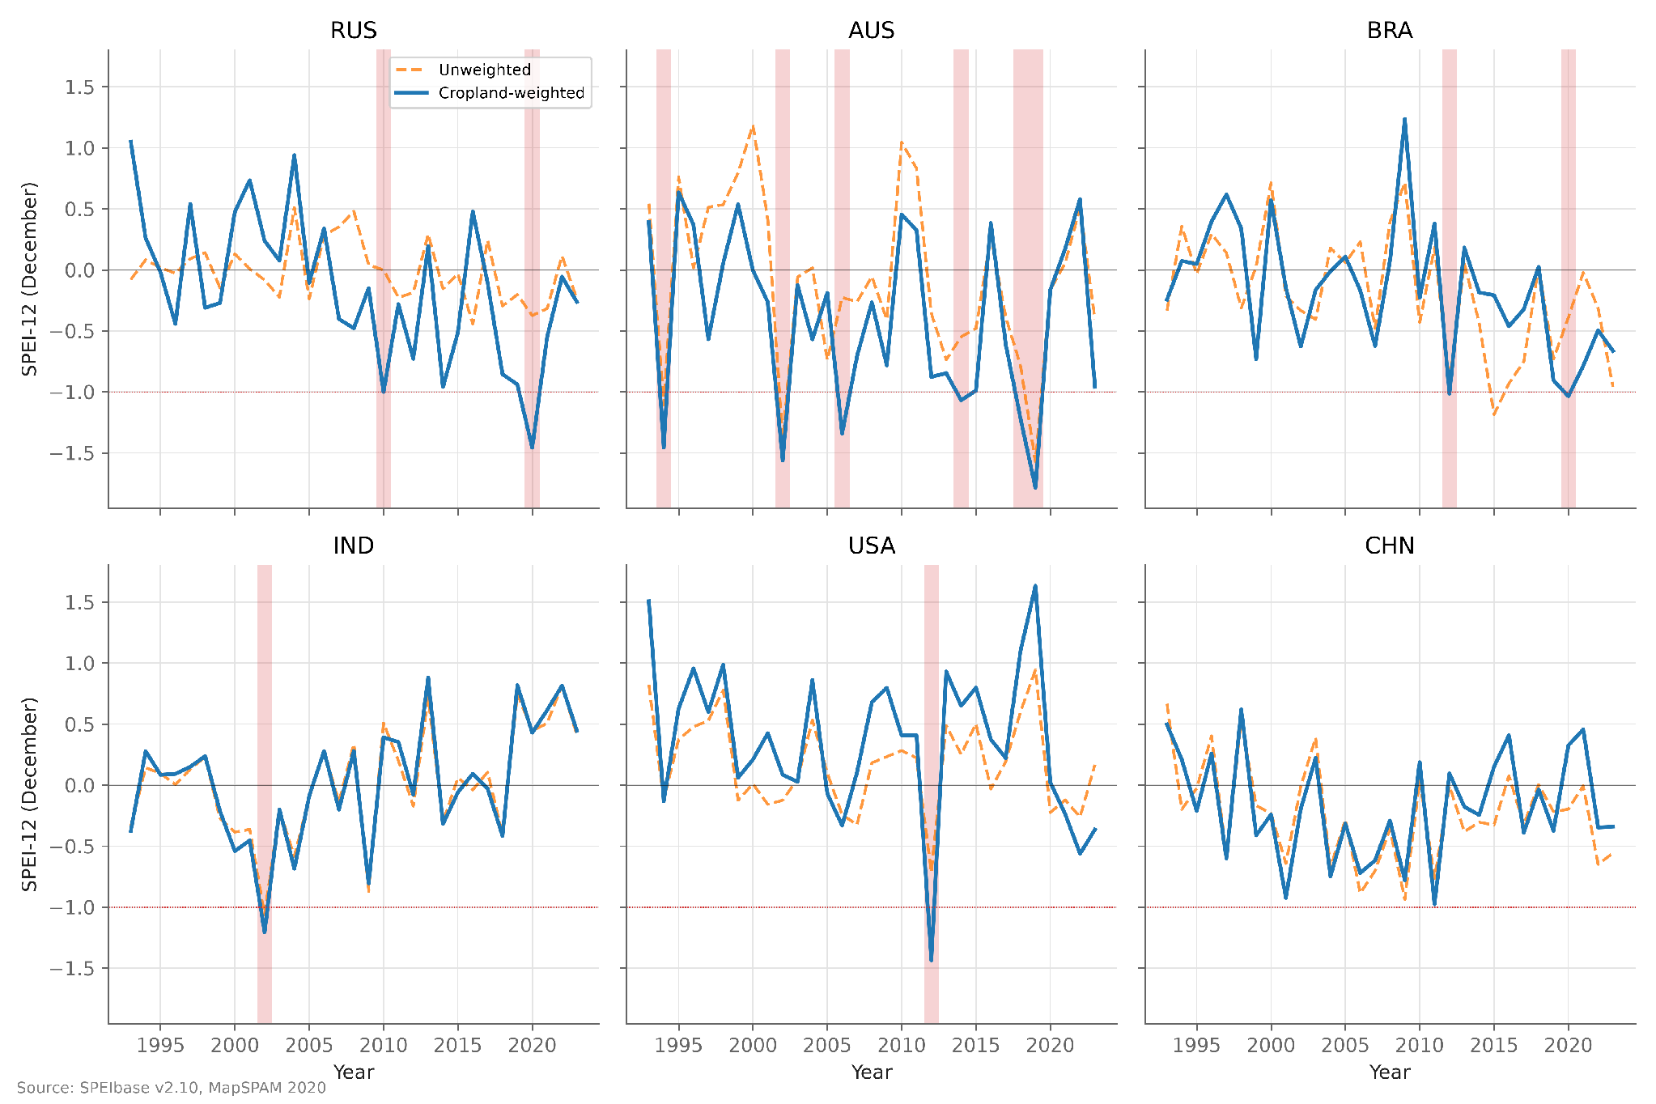
METHODOLOGY
08 / 26
Drought measured over cropland, not whole countries
SPEI-12
drought index, cropland-weighted
Blue is the drought index averaged where crops grow; orange is the same index averaged over the whole country; shaded years have SPEI-12 at or below −1. The two differ most where farmland is concentrated, as in Russia and Australia. In the USA only the cropland-weighted line marks 2012 as a drought.

Slide 9
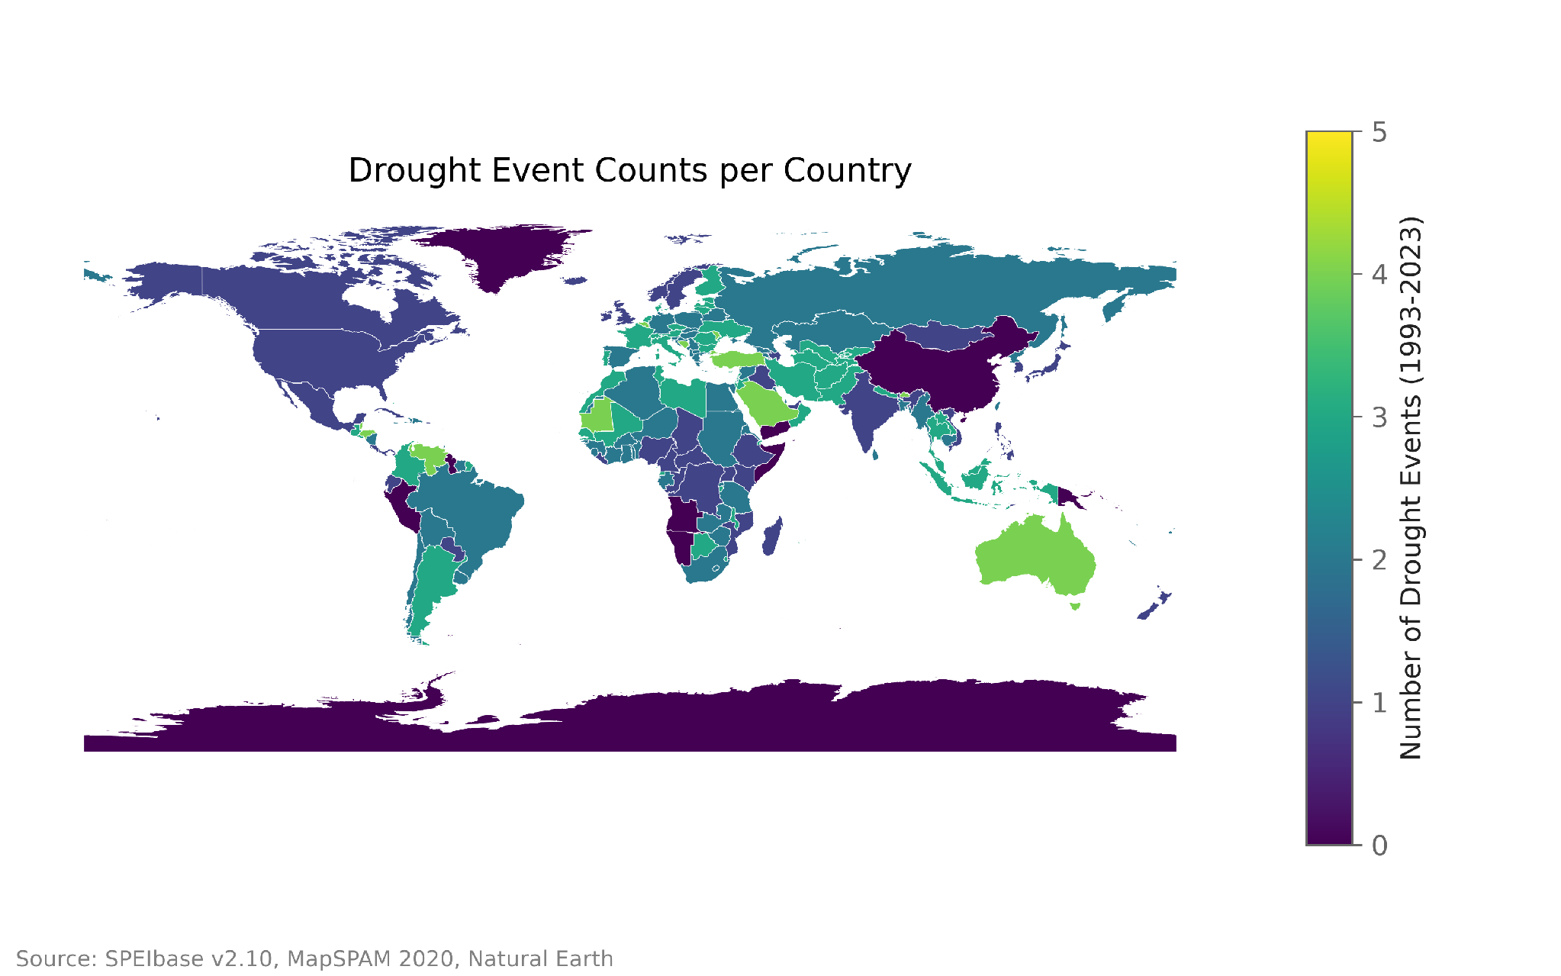
METHODOLOGY
09 / 26
Drought events, 1993–2023
431
events in 187 countries
An event is the first year of a run of drought years (December SPEI-12 ≤ −1), kept only if the three years before were drought-free and three years after fall inside the window. The map counts events per country; 232 events fall in the 107 countries analysed.

Slide 10
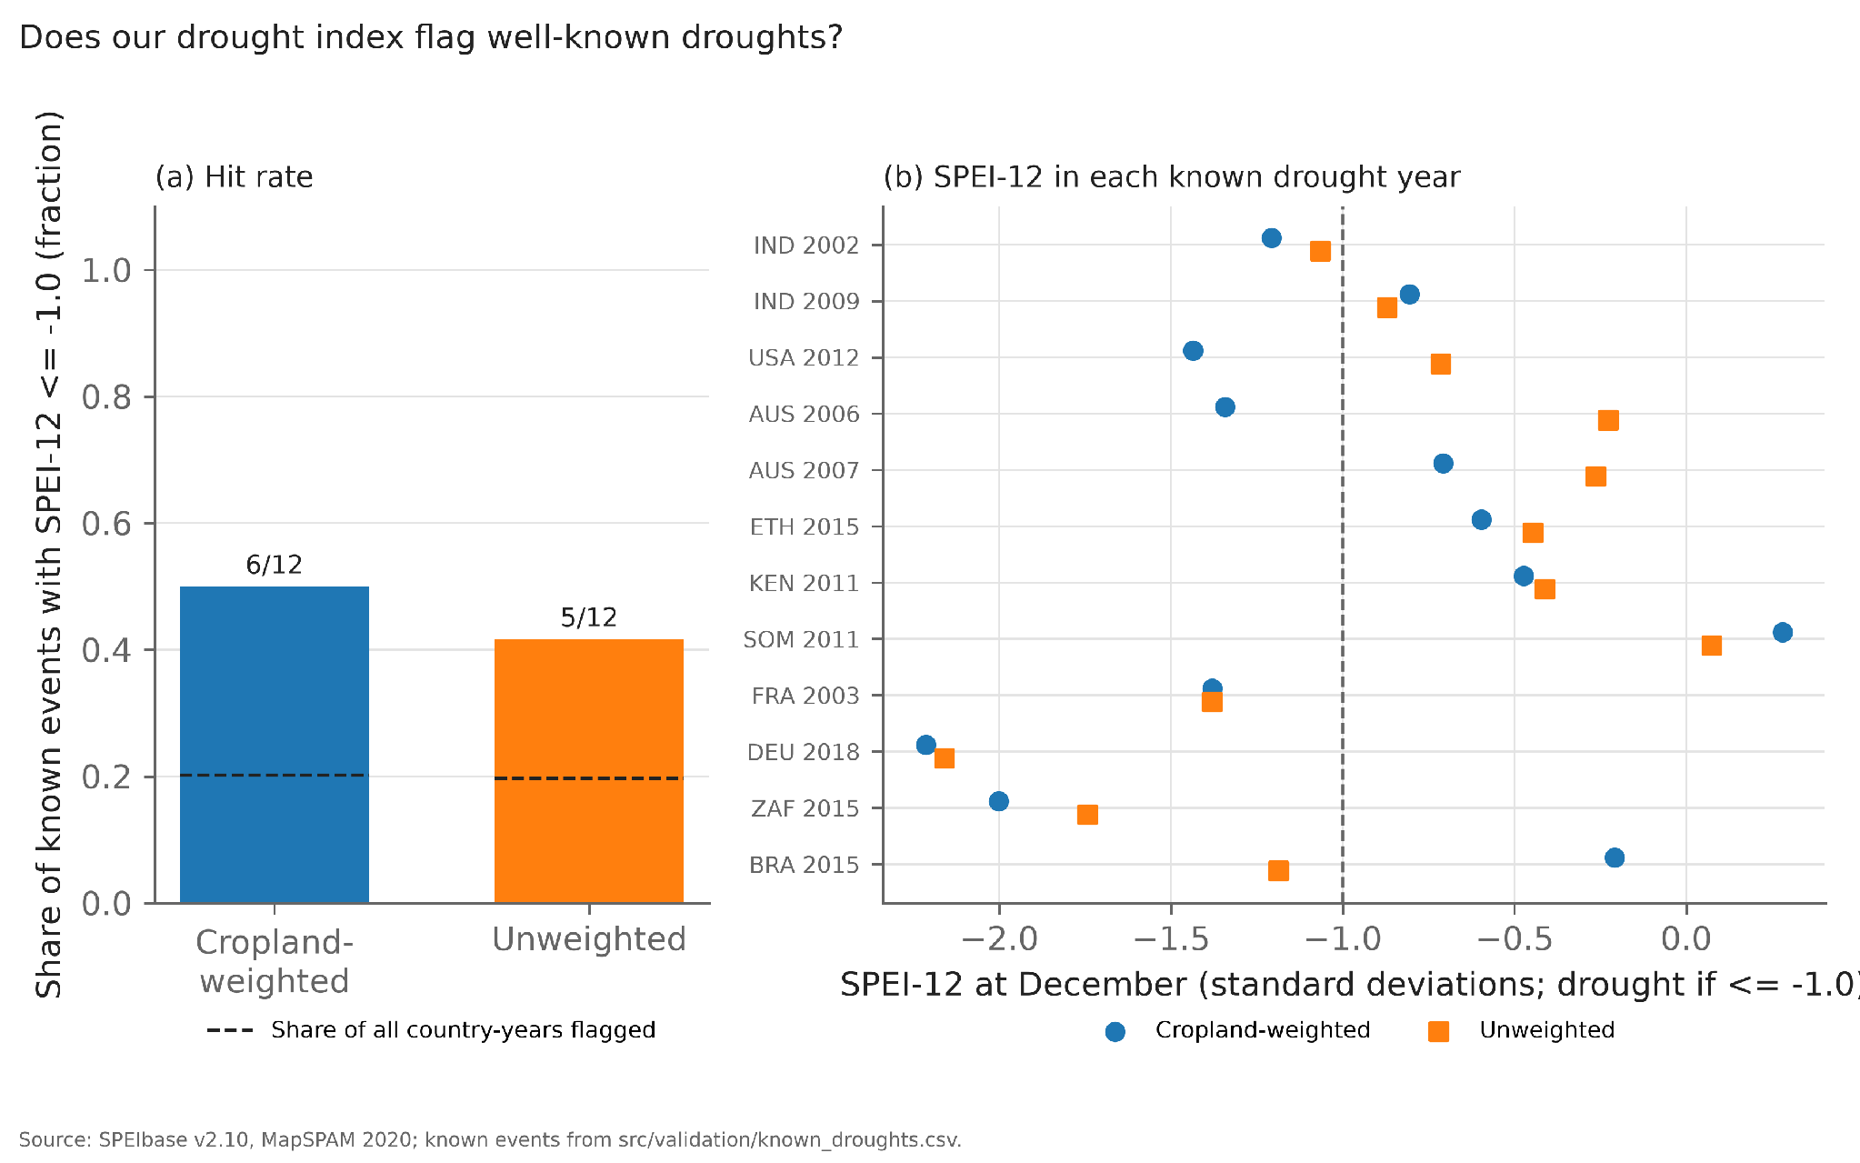
METHODOLOGY
10 / 26
Check against 12 documented droughts
6 / 12
flagged with cropland weights
Left: share of 12 documented droughts flagged; the dashed line is the share of all country-years flagged (about 20%), so both versions beat chance. Right: SPEI-12 in each drought year, flagged when left of −1. Whole-country SPEI flags 5 of 12; allowing ±1 year the weighted index reaches 7 of 12. East Africa 2011 and Brazil 2015 are missed.

Slide 11
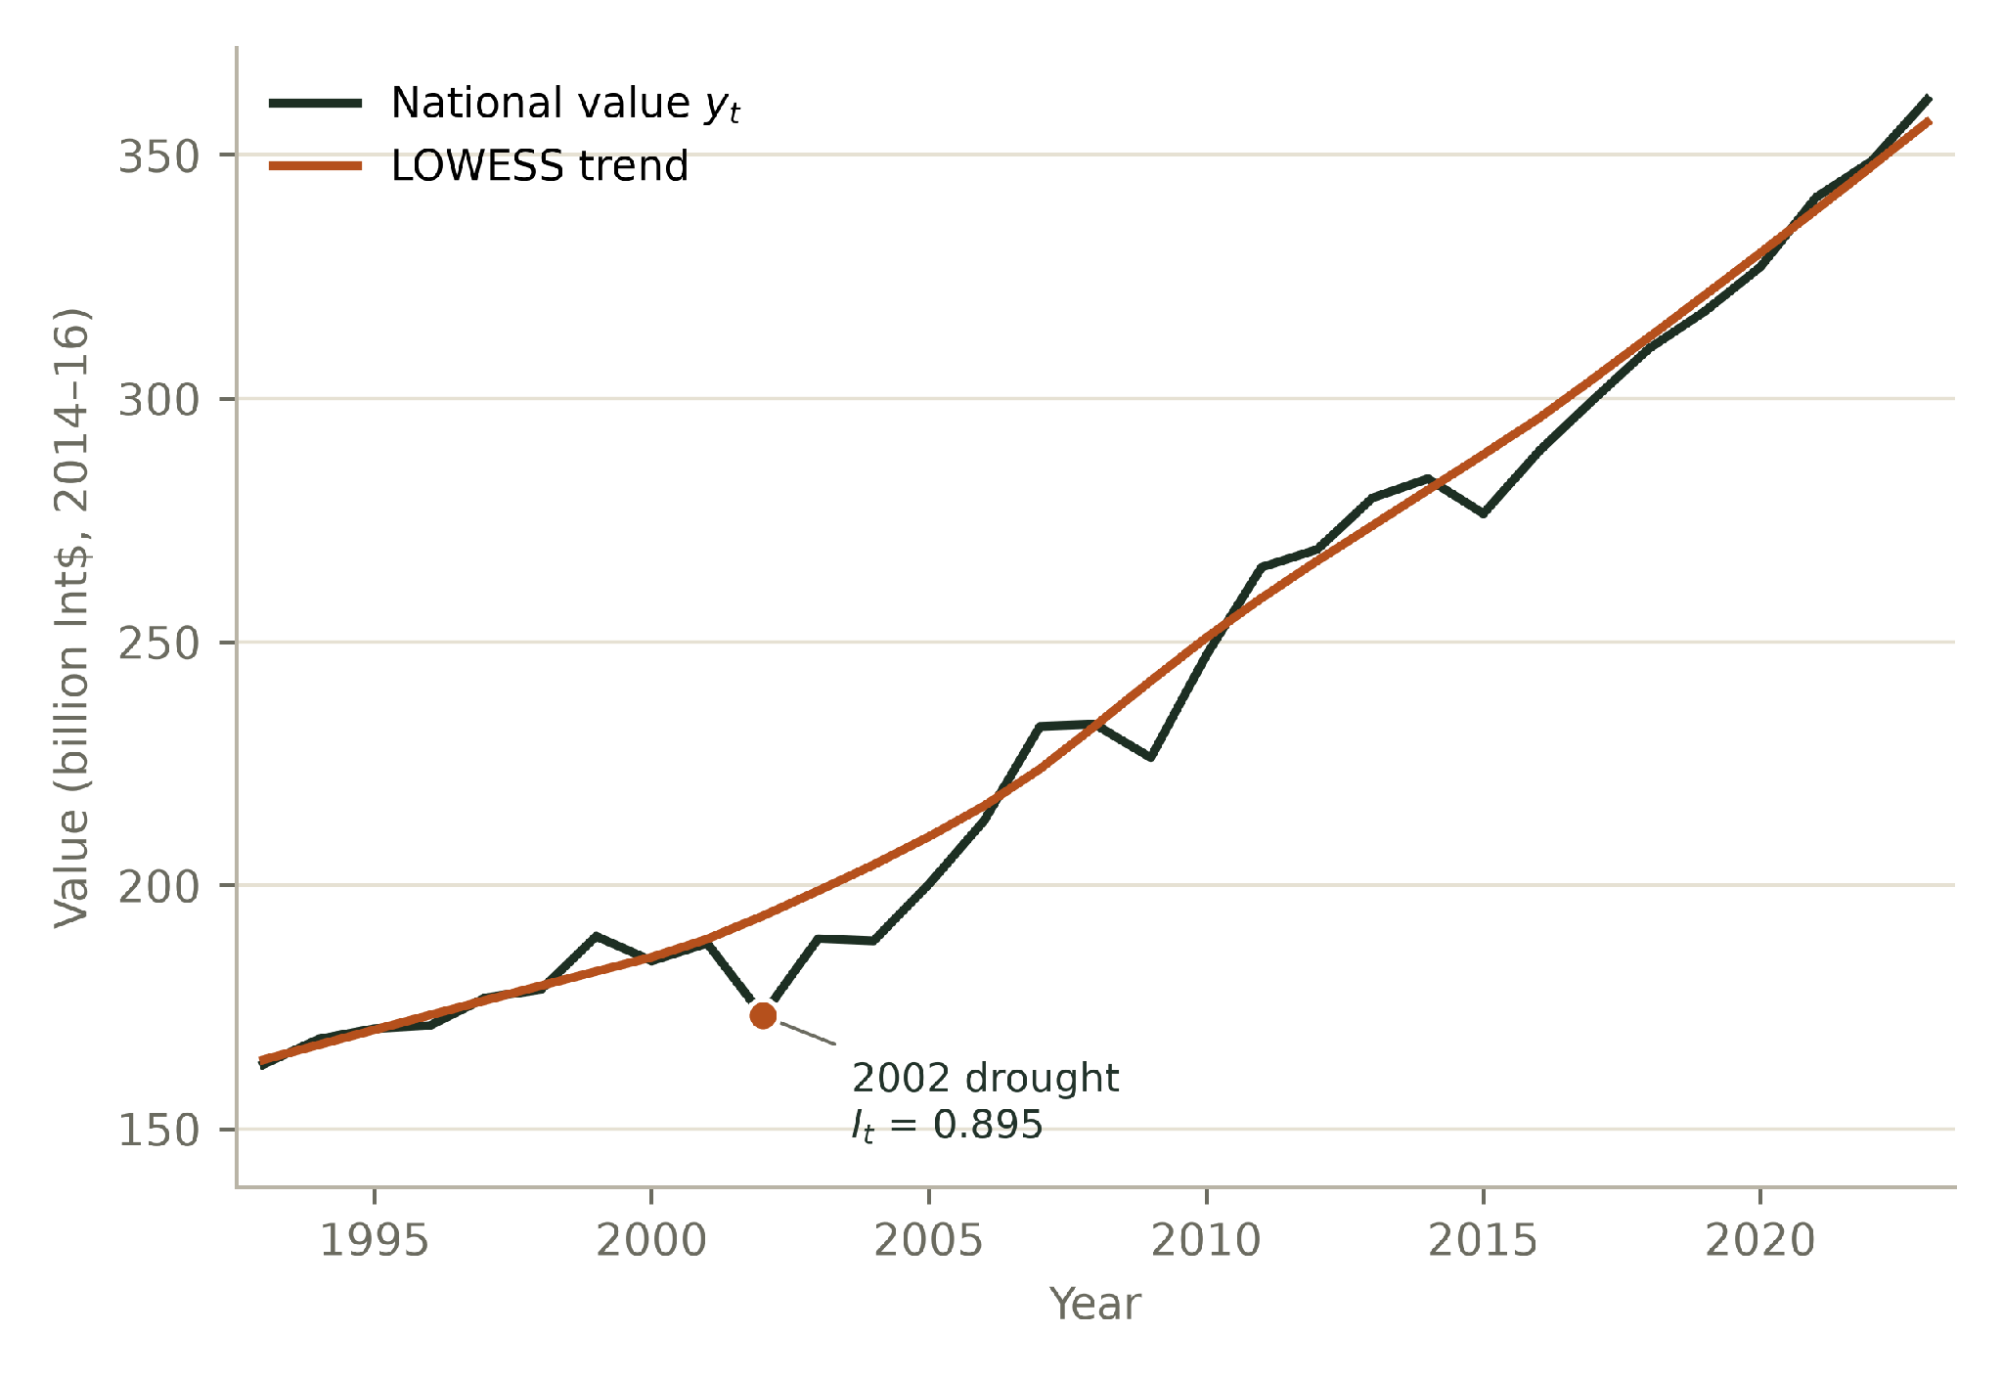
METHODOLOGY
11 / 26
How we calculate: diversity and the value index
1
India: national crop value and its LOWESS trend
Crop diversity, hill1
hill1 = exp( −Σ pᵢ ln pᵢ )
pᵢ = crop i’s share of mean harvested area, 1993–2023. It is the effective number of crops: it equals the crop count if all share area equally and falls when a few crops dominate. India: 18.9; median 9.2.
2
National value, yₜ
yₜ = Σ value_const over crops
Gross production value in constant 2014–16 international dollars, so crops can be added. Tonnes are never summed across crops.
3
Detrend to get Iₜ
Iₜ = yₜ / trendₜ
Trend is LOWESS (frac 0.5) on 1993–2023. Iₜ = 1 is on trend, 0.9 is 10% below. Anomaly aₜ = (yₜ − trendₜ) / trendₜ.
The dip below the trend in 2002 gives Iₜ = 0.895. Everything that follows is measured on Iₜ, so long-run growth from better inputs is not mistaken for resilience.
Source: FAOSTAT QV; India series from outputs/metrics_national.parquet
Notes:
hill1 is computed in src/metrics/diversity.py; the trend and index in src/metrics/detrend.py. Imputed rows stay in the national sum; crop-level response fits use reported years only.

Slide 12
METHODOLOGY
12 / 26
The four faces of resilience: how each is calculated
Stability
Resistance
Recovery
Vulnerability
1 / CV
Iₜ / mean( Iₜ₋₃ … Iₜ₋₁ )
mean( Iₜ₊₁ … Iₜ₊₃ ) / Iₜ
share of years with Iₜ < 0.9
CV = sd( yₜ − trendₜ ) / mean( yₜ )
Median over drought events; t = event year
Median over drought events
Loss of more than 10% below trend
Higher means smaller swings around the trend. Uses all 31 years.
1 means no loss in the drought year; below 1 is a loss against the three years before.
Above 1 means the next three years rebound beyond the drought-year level.
Higher means more bad years. vuln_drought counts only years with SPEI-12 ≤ −1.
India 34.7
India 0.89
India 1.05
India 0.03
median 13.0
median 0.98
median 1.02
median 0.10
Which years count. Resistance and recovery use only drought events: 232 events in 102 countries, each with three drought-free years before and three years after inside 1993–2023. Countries with no usable event get no value. Stability and vulnerability use every year, so they describe chronic instability rather than one shock.
Notes:
Formulas are the fixed choices in CLAUDE.md. Medians are across the 107 included countries (outputs/stats/summary.csv). India values from outputs/metrics.parquet.

Slide 13
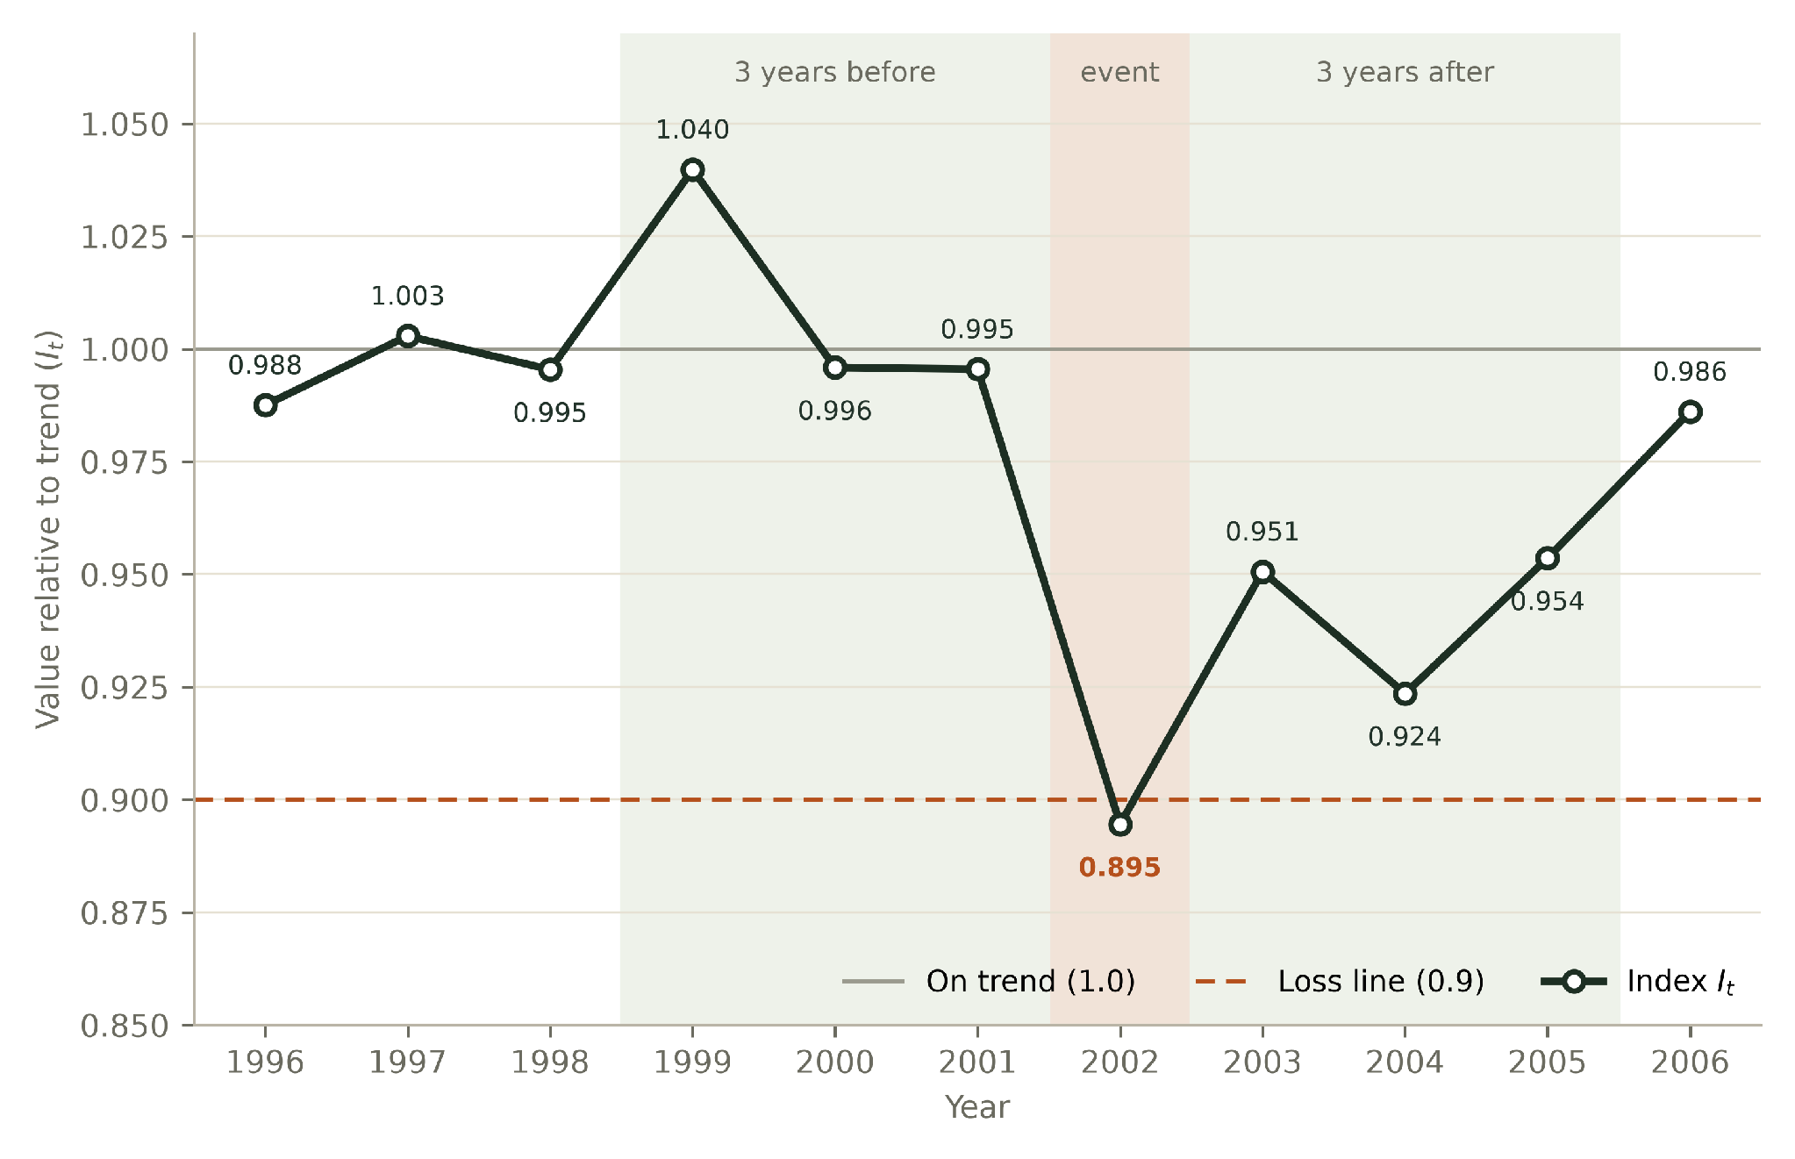
METHODOLOGY
13 / 26
Worked example: India’s 2002 drought
India national value index Iₜ, 1996–2006
Event year t = 2002
SPEI-12 = -1.21, with no drought in 1999–2001, so 2002 starts an event. Iₜ = 0.895.
Resistance
Before: (1.040 + 0.996 + 0.995) / 3 = 1.010
0.895 / 1.010 = 0.89
Recovery
After: (0.951 + 0.924 + 0.954) / 3 = 0.943
0.943 / 0.895 = 1.05
Vulnerability
2002 is the only year of 31 below 0.9, so 1 / 31 = 0.03. It was a drought year, so vuln_drought = 1 / 1 = 1.0.
India has one usable event, so its resistance and recovery rest on this single drought.
Notes:
Recomputed from the national index; matches outputs/metrics.parquet (resistance 0.885, recovery 1.054, vulnerability 0.032, vuln_drought 1.0).

Slide 14
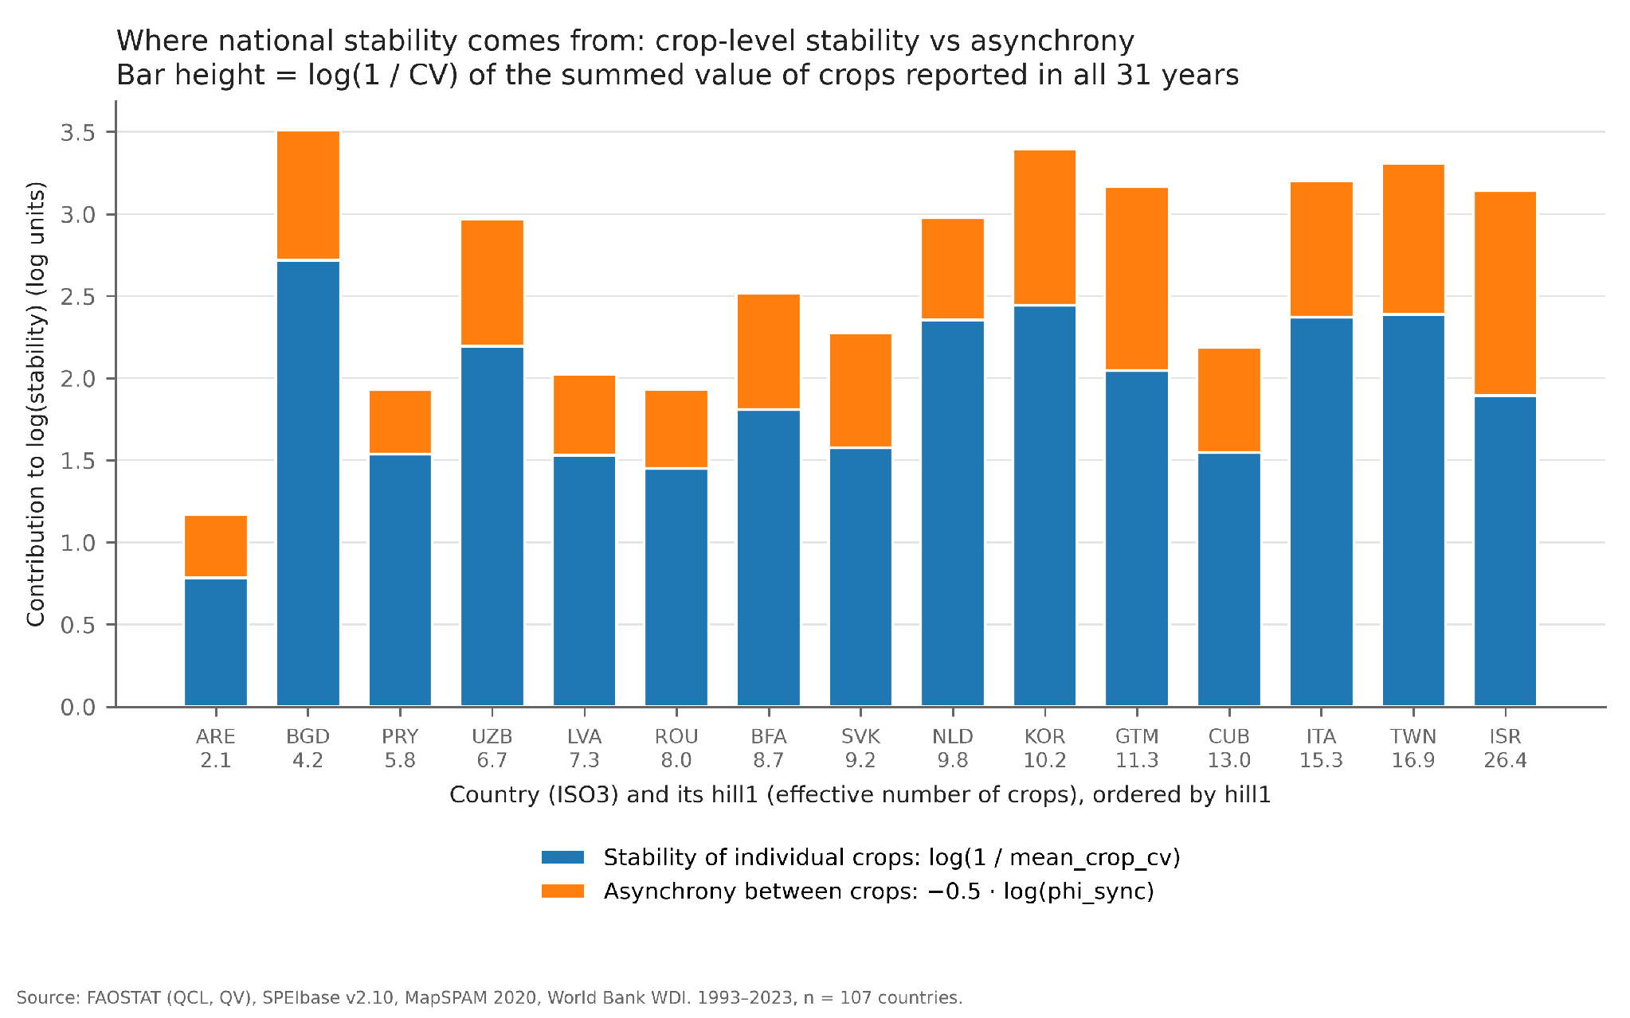
METHODOLOGY
14 / 26
Where national stability comes from
0.23
median synchrony between crops
Each bar is a country’s log stability, split into two parts. Blue: how steady its individual crops are. Orange: how out of step they are (on a 0–1 scale where 1 means all crops move together). Both add to stability, and in the more diverse countries, such as Israel, the out-of-step part is a larger share.

Slide 15




METHODOLOGY
15 / 26
How we test the link between diversity and resilience
Rank correlation
Regression with controls
Spearman ρ between each predictor (hill1, resp_div) and each face, with 95% bootstrap intervals from 2,000 resamples of countries. n = 107 for hill1.
OLS with outcome and predictors standardised, so a coefficient is the change in SD per SD. Controls: log GDP per capita, fertiliser use and irrigation share (window means). Robust HC3 errors; n = 96–101, as merged entities lack WDI series.
Robustness
Extra checks
Repeat the correlations with LOWESS frac 0.3 and 0.7, severe droughts only (≤ −1.5), countries with at most 10% imputed value, and each world region left out in turn.
Response-diversity paradox: resp_div against the most sensitive single crop. Spatial dilution: country area against SPEI variance. Flash droughts: 6-month against 12-month index versus yield anomalies.

Slide 16
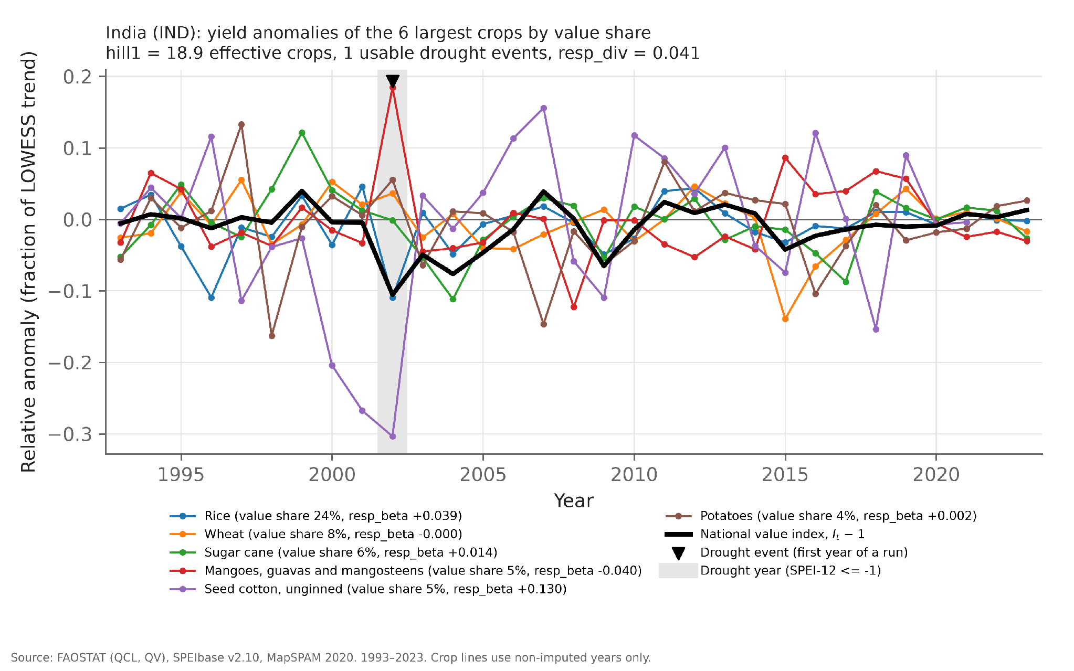
METHODOLOGY
16 / 26
One country in detail: India
−10%
national value against trend, 2002
Thin lines are the yield anomalies of India’s six largest crops; the thick black line is the national value index minus 1; the grey band is the drought year. In 2002 cotton yield fell about 30% and rice about 11%, while mango yield rose, so the national index ended about 10% below trend. India grows 18.9 effective crops, and the spread of responses cushioned the loss.

Slide 17
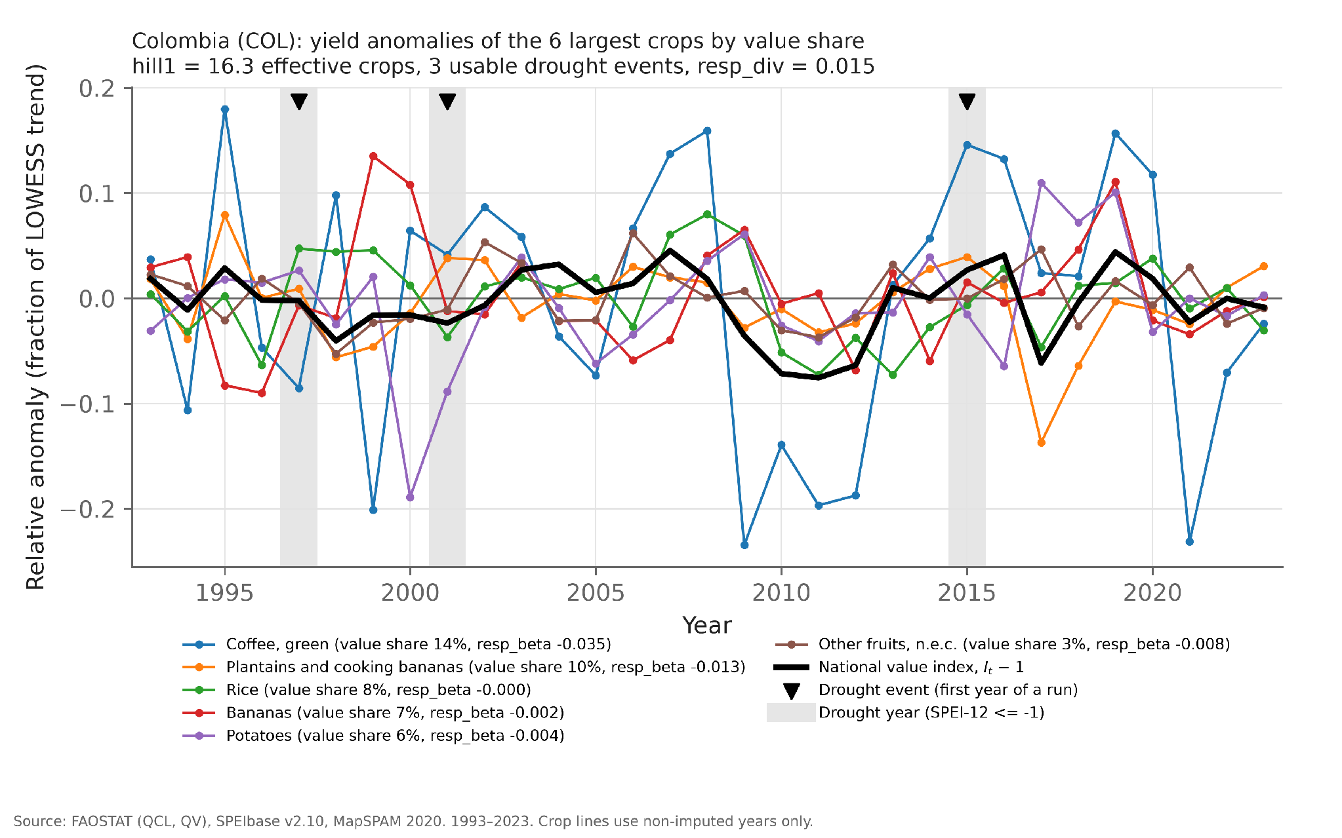
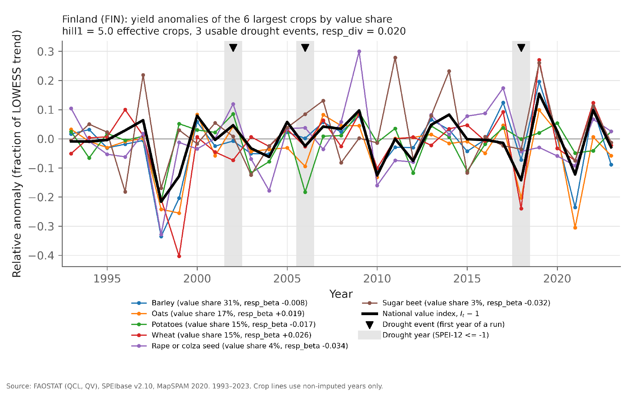
METHODOLOGY
17 / 26
Two contrasting countries: Colombia and Finland
Colombia: 16.3 effective crops
Finland: 5.0 effective crops
Stability 29.3 · synchrony 0.06 · bad years 0 of 31
Stability 12.3 · synchrony 0.36 · bad years 5 of 31
Coffee swings between about −23% and +18% of trend, yet the national value index (thick black line) never falls more than about 8% below trend, because other crops move out of step. The three drought events (triangles) leave no clear mark on the national line.
Barley, oats, wheat and potatoes tend to fall in the same years, so the national line follows them. The deepest dip, 1998 at about −22%, is not a drought year; in the 2018 drought the national index fell about 14% below trend, with wheat down about 24%.

Slide 18
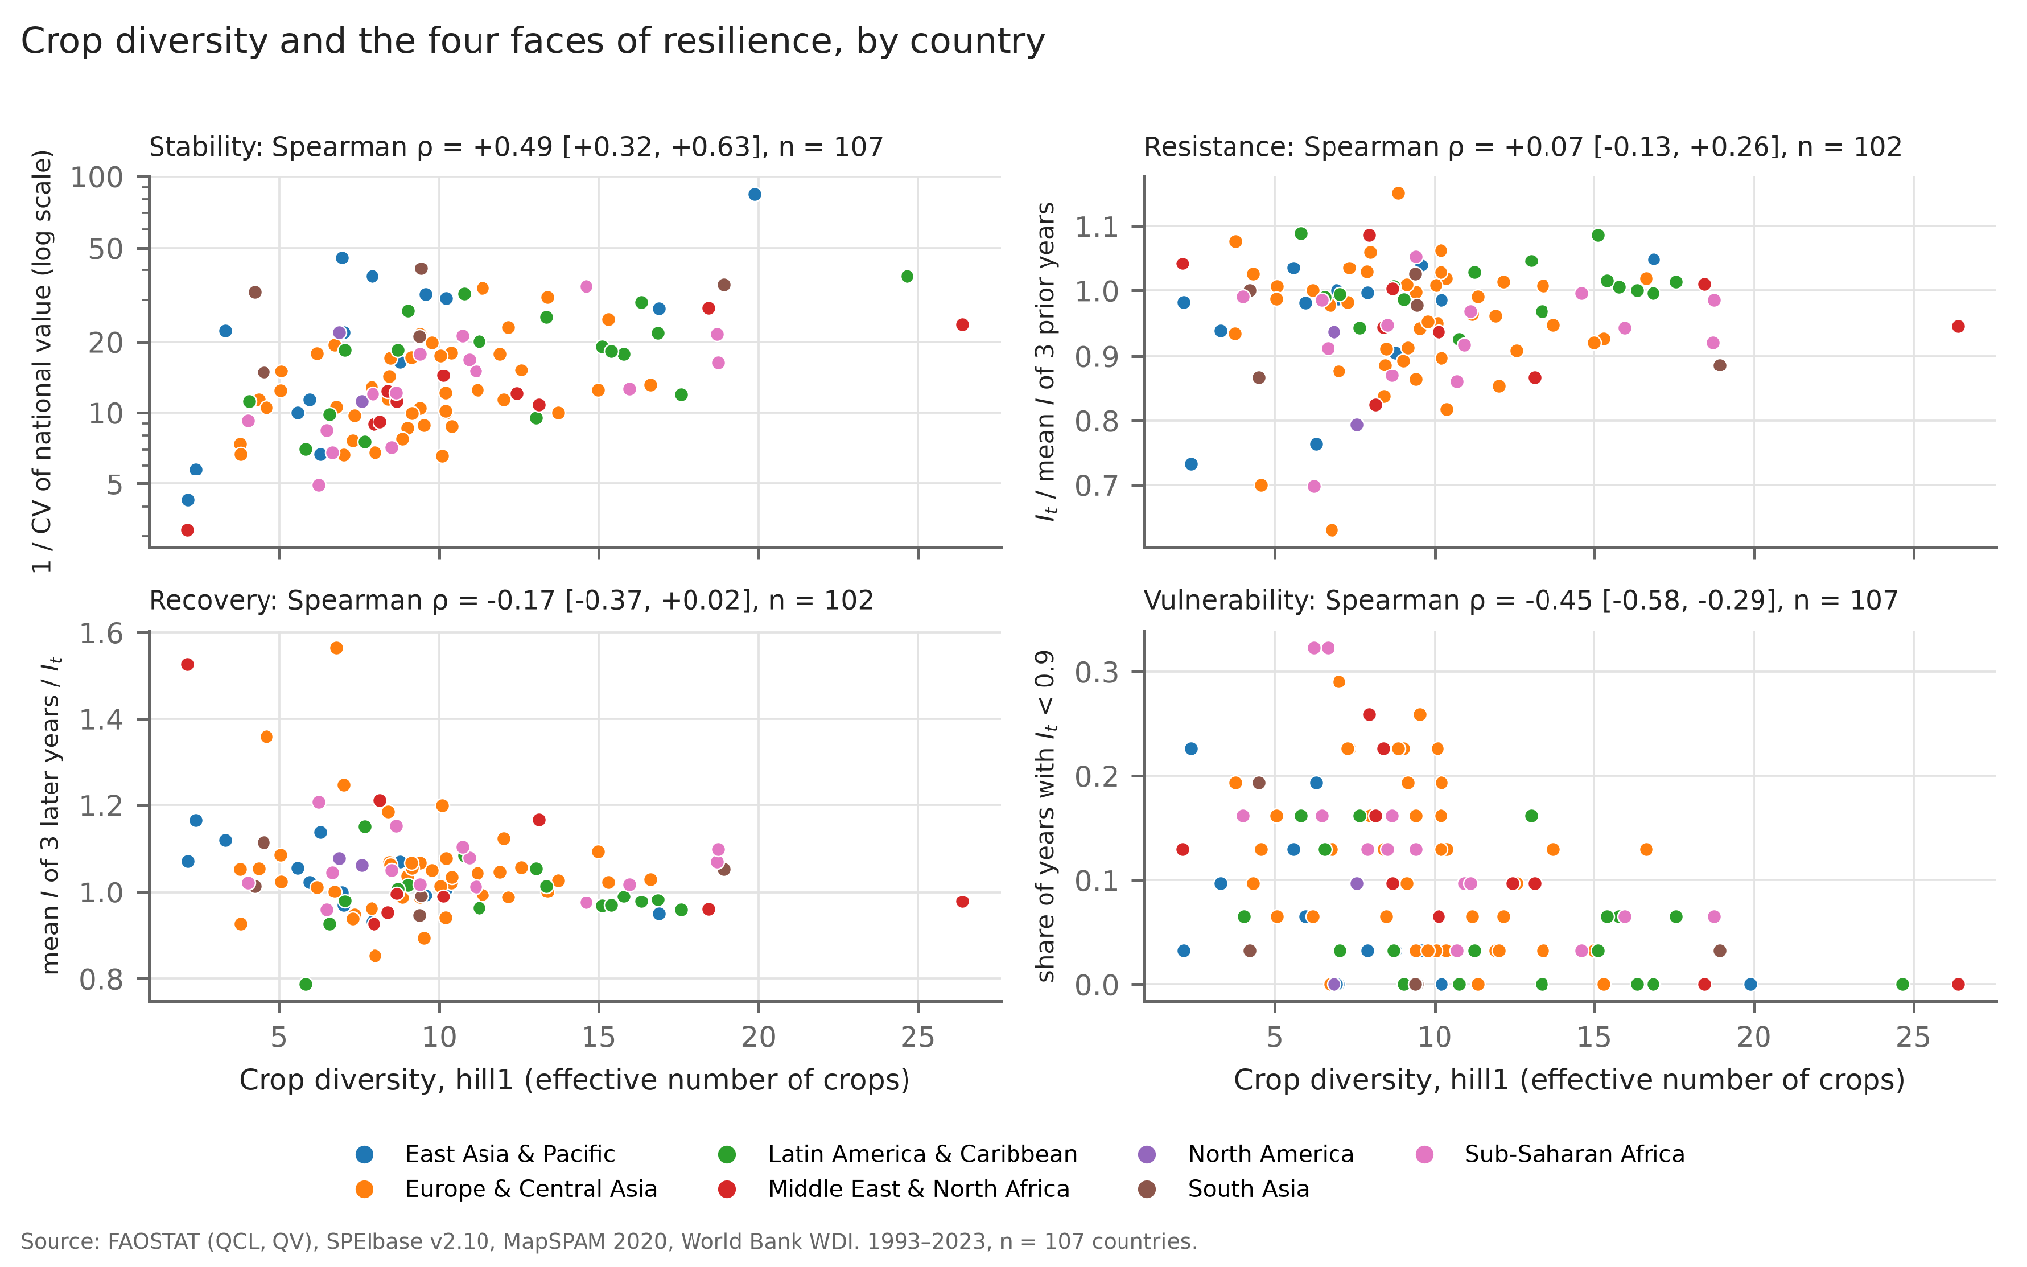
RESULTS
18 / 26
Crop diversity and the four faces of resilience
+0.49
diversity and stability
Each dot is a country, coloured by region; the x-axis is crop diversity (hill1). Stability rises with diversity (+0.49) and the share of bad years falls (−0.45). Resistance (+0.07) and recovery (−0.17) show no clear link: their intervals include zero and the dots form a flat cloud.

Slide 19
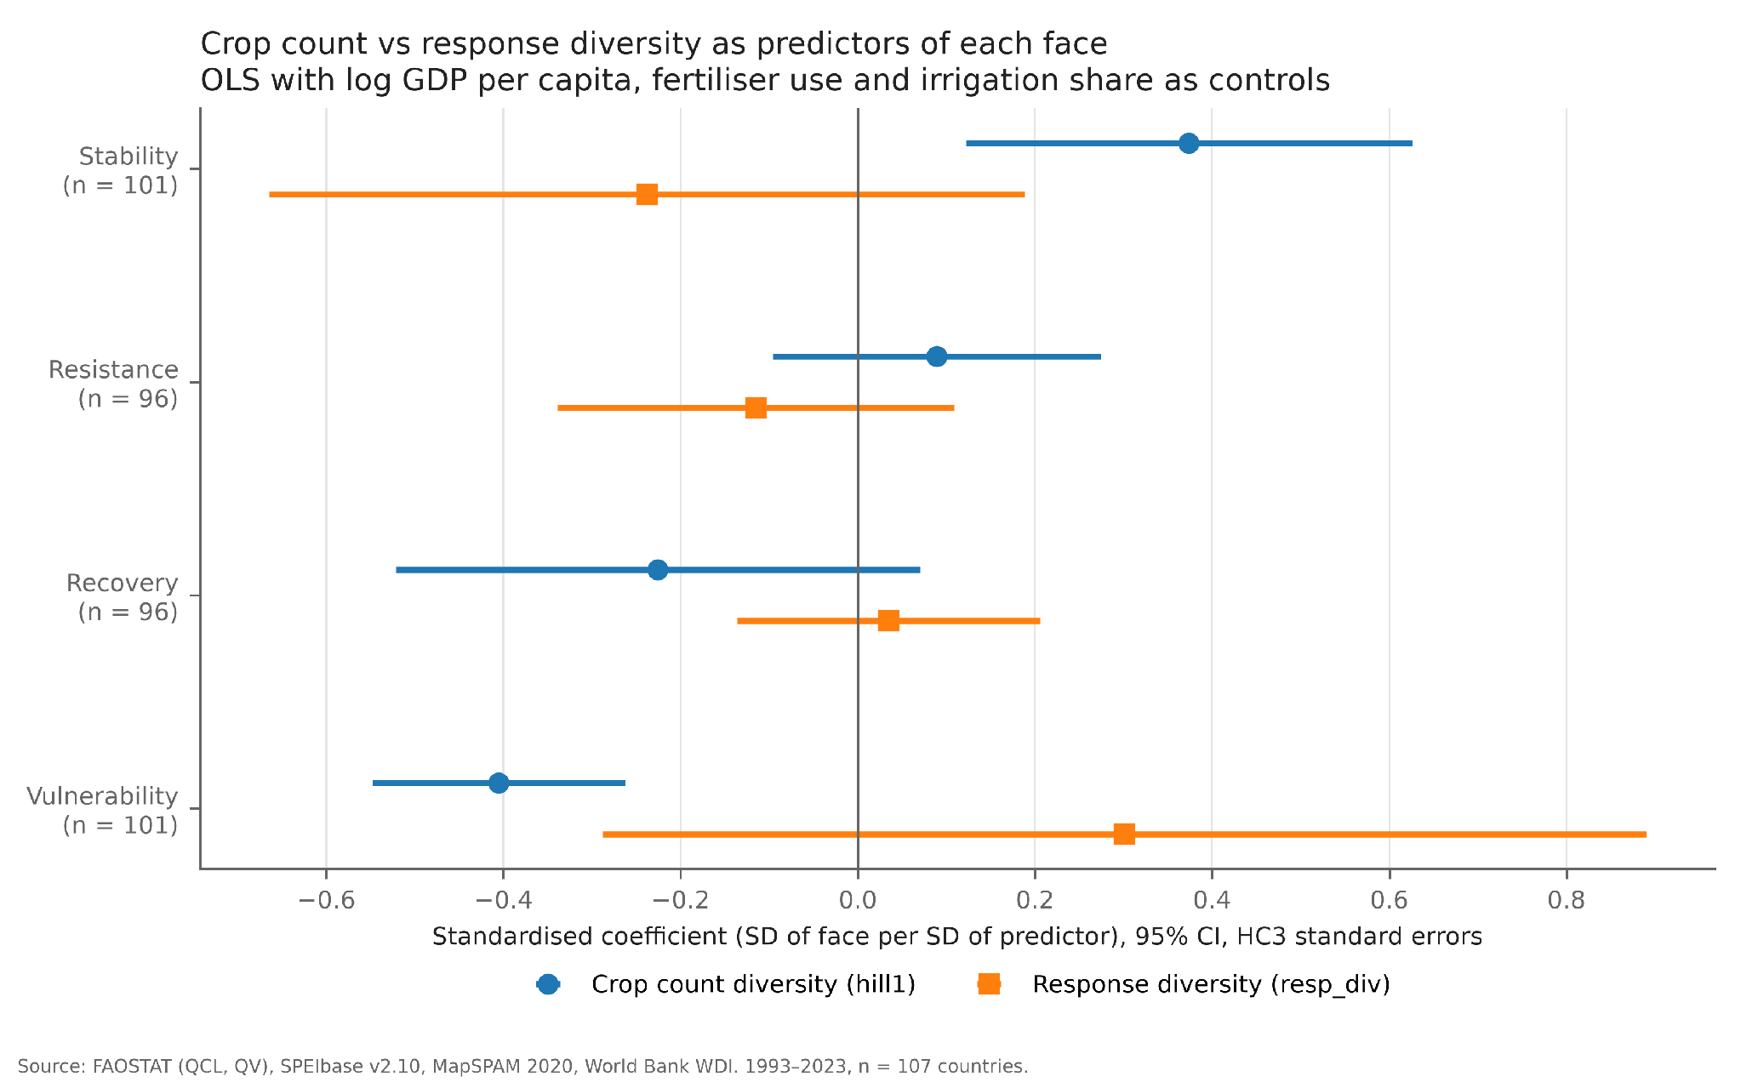
RESULTS
19 / 26
Crop count against response diversity
−0.41
vulnerability per SD of crop diversity
Dots are standardised regression coefficients with 95% intervals; an interval crossing zero means no clear effect. With income, fertiliser and irrigation held constant, crop diversity still predicts stability (+0.37) and fewer bad years. Response diversity does not predict stability or overall vulnerability, but it goes with more losses in drought years (+0.36).

Slide 20
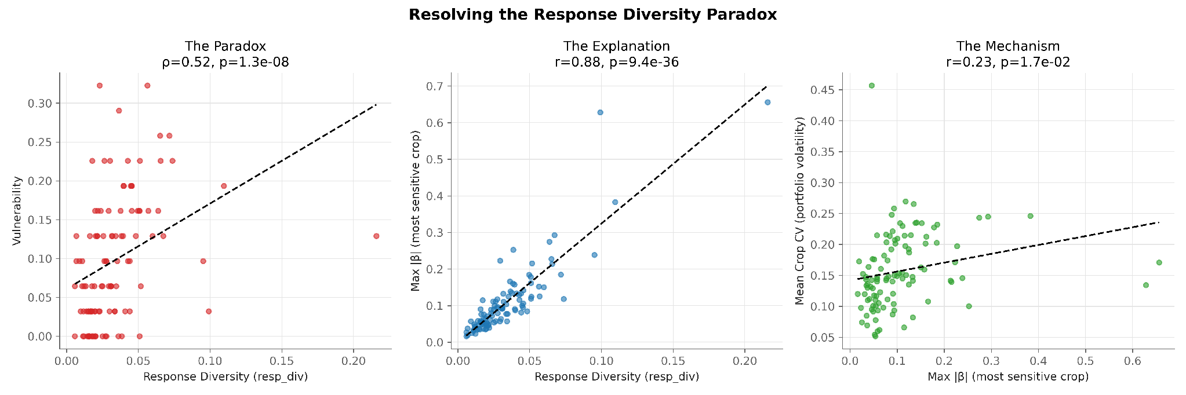
RESULTS
20 / 26
Why response diversity points the other way
+0.52
0.88
Left: countries with higher response diversity have more bad years, the opposite of the insurance idea. Middle: the score tracks the single most drought-sensitive crop almost one for one (r = 0.88). Right: that crop also makes the portfolio more variable. A high score mostly marks one hyper-sensitive crop, not a balanced mix of responses.
response diversity and vulnerability
response diversity and the most sensitive crop

Slide 21
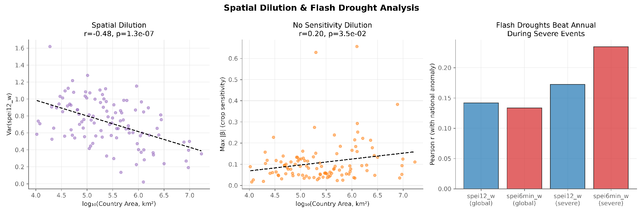
RESULTS
21 / 26
Country size and short droughts
−0.48
0.23 vs 0.17
Left: the bigger the country, the flatter its averaged drought index, because dry and wet regions cancel. Middle: crop sensitivity does not shrink with size (r = +0.20). Right: correlation of each index with yield anomalies; in the 240 severe country-years (SPEI-12 below −1.5) the six-month minimum tracks losses better than the annual index.
country area and spread of the drought index
six-month vs twelve-month index, severe years

Slide 22
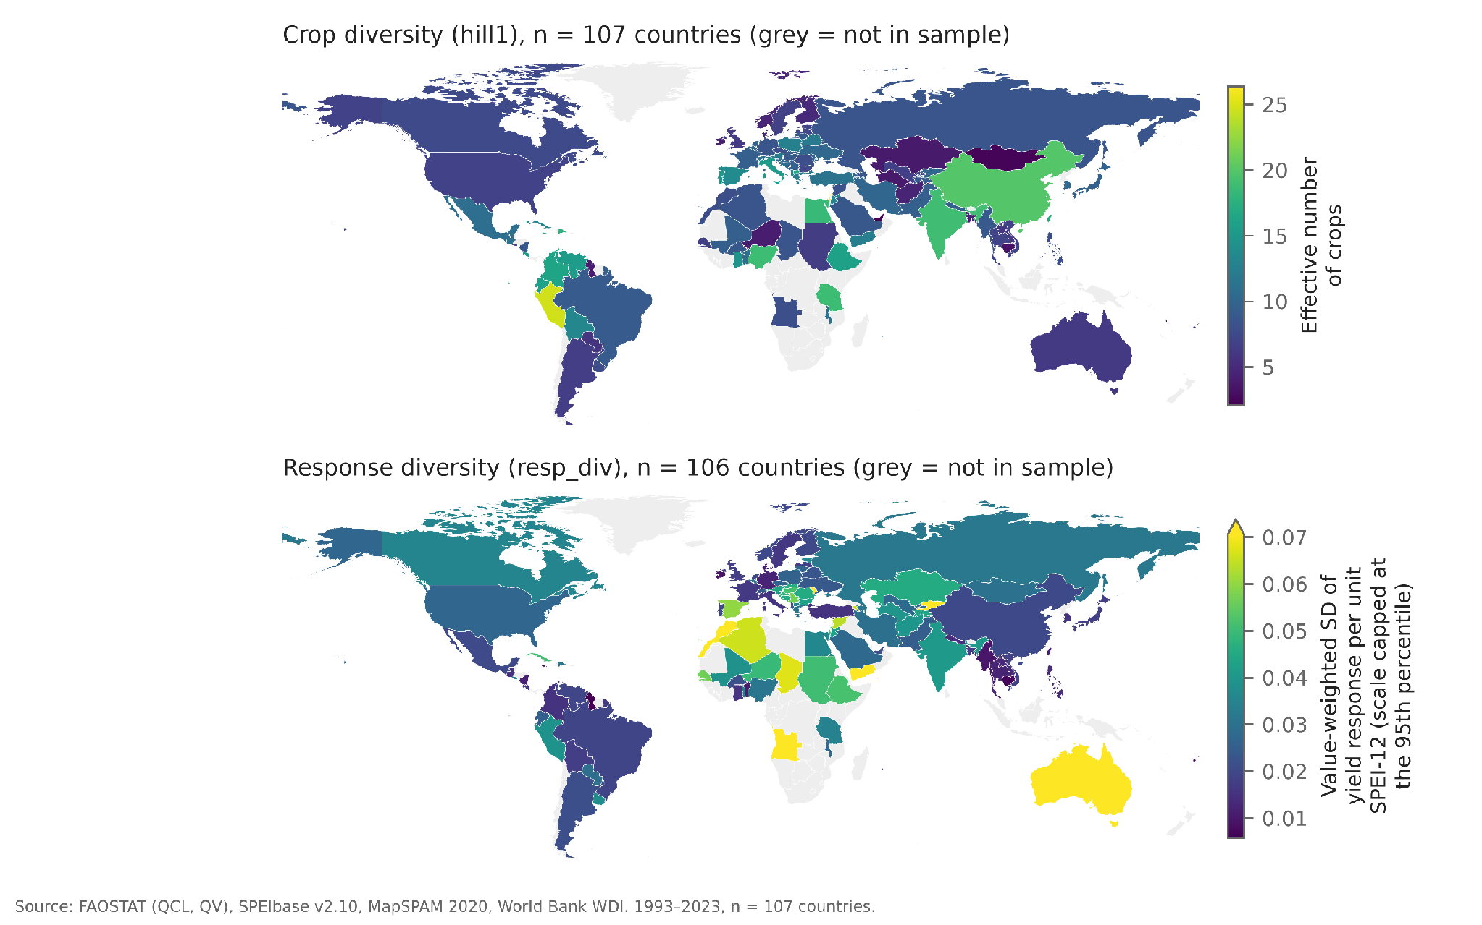
RESULTS
22 / 26
Diversity across the sample
9.2
median effective number of crops
Top map: crop diversity (hill1). Bottom map: response diversity (resp_div), plotted for 106 countries. Crop diversity ranges from about 2 to 26 effective crops: China, India and Peru are high, while Mongolia and much of Central Asia are low. Response diversity is highest in North Africa and Australia (scale capped at the 95th percentile). Grey countries did not pass the data-quality rules.

Slide 23
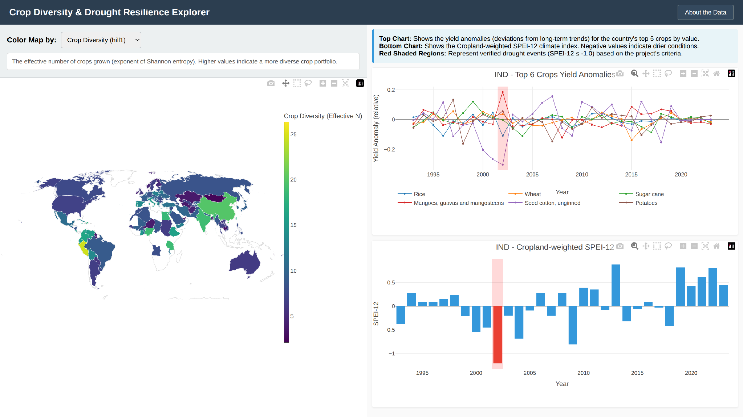
RESULTS
23 / 26
Interactive explorer
107
countries to open and compare
Pick a metric. The map recolours by crop diversity, response diversity, stability, resistance, recovery, vulnerability or synchrony.
Click a country. The right panels show the yield anomalies of its six largest crops and its cropland-weighted SPEI-12, with drought years shaded.
Screenshot: India. The cotton collapse lines up with the shaded 2002 drought year.
Notes:
Live demo: open explorer/index.html in a browser with internet access (Plotly is loaded from cdn.plot.ly). Screenshot was taken with India preselected.

Slide 24
OBSERVATIONS
24 / 26
What the evidence shows
1
Diversity buys steadiness, not shock absorption
2
The link survives controls
Stability rises (ρ +0.49) and bad years fall (−0.45) with crop diversity. Resistance (+0.07) and recovery (−0.17) in single droughts show no clear link.
Holding income, fertiliser and irrigation constant, crop diversity still predicts stability (+0.37 SD) and vulnerability (−0.41 SD). Irrigation also lowers vulnerability in drought years (−0.32).
3
More varied crop responses did not help
4
How drought is measured matters
Response diversity tracks the single most drought-sensitive crop (r = 0.88) and goes with more bad years (ρ +0.52). It marks an outlier crop, not balance.
Averaging over large countries mutes the signal (r = −0.48), and in severe years the six-month index tracks losses better (0.23 vs 0.17). The cropland-weighted index flags 6 of 12 known droughts.

Slide 25



OBSERVATIONS
25 / 26
Future work
Seasonal drought events
The 88 excluded countries
Define events with the six-month index, which tracked severe losses better and may catch the known droughts we missed.
Test looser data rules or national statistics, so producers such as Indonesia and South Africa enter the sample.
A sturdier response metric
Below the national scale
Separate real differences in crop response from one outlier crop and from noisy yield records.
Repeat with state or district data, where averaging over large areas hides less of the drought.

Slide 26
ENVIRONMENTAL SCIENCE AND TECHNOLOGY
Thank you
Questions are welcome :)
Data: FAOSTAT, SPEIbase v2.10, MapSPAM 2020, World Bank WDI, Natural Earth

